Slide 1
ISU Green Your Residence

Slide 2
Client
DEC1612
Merry Rankin
Steve Kohtz
Sindhuja Ram
Laurelin Haas
Office of Sustainability
Bri Gerads
Guan Keng Lim
Daniel Cain
Dr. Samik Basu Advisor

Slide 3
Project Scope
The Office of Sustainability aims to engage students in living a sustainable lifestyle. By providing students with a free, interactive web application, the hope is to inform, engage and empower students to cultivate sustainable habits towards a sustainability ethic that is carried past their time in college onto their lives and community involvement outside of Iowa State University.
Notes:
Guan

Slide 4
Project Breakdown
It shall provide information on Green Living
It shall quiz users on their green living and provide them with a green score
It shall engage students by allowing them to build their residence and decorate it
It shall allow students to create a Savings Cart by selecting items in their residence and comparing it to energy star items
It shall allow the client to edit the page with admin abilities
Notes:
Guan

Slide 5
Requirements
Functional
Interactive Dorm Room Builder
Drag-and-Drop
Hover popup
Interactive Quizzes
Savings Cart
Admin Page
Non-Functional
Web Design matches iastate.edu domain design standards
Admin Page shall be highly user-friendly
Loading time of website shall be optimized
Notes:
Guan

Slide 6
Technology Used
AngularJS - Object system to allow for procedurally-generated content
FabricJS - Javascript canvas library
HTML/CSS/Javascript - Front end interface and functionality
Bootstrap & Materialize - Front end layout formatting and styling
SQL Database - Stores information for website
Node.js - Connects back end to front end of website
Notes:
Guan

Slide 7
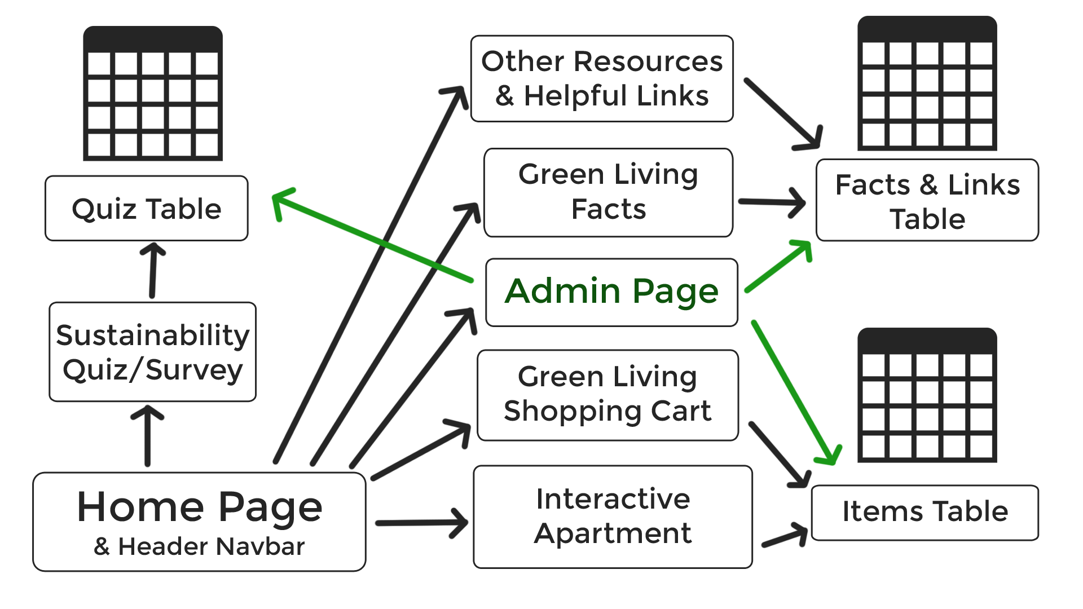
Design

Slide 8
User Experience

Slide 9
UI Designs
Color
Positive client feedback
Matches ISU Office of Sustainability website
Intuitive: focus on Green Living information

Slide 10
Technical Challenge #1
Access Denied from pre-existing website development environment:
Prevented from using the Office of Sustainability’s CMS, object system, and admin curation setup
Solution:
Created a new object system with AngularJS
Set up a new database for website content with Node
Created a new admin curation environment

Slide 11
Evolution of Design - Front-End
Focus on Functionality
Focus on User Experience
Focus on Visual Design

Slide 12
Home Page

Slide 13
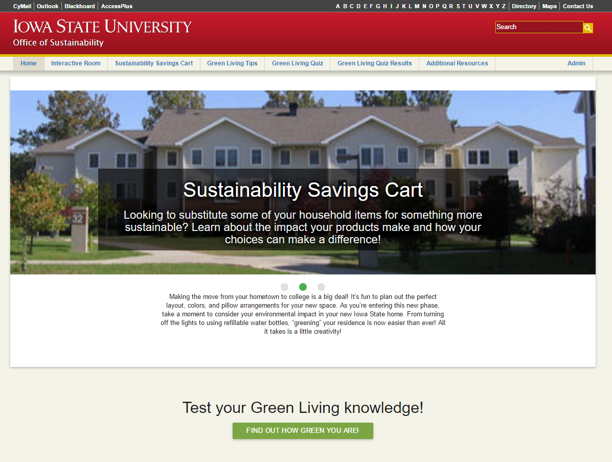

Slide 14
Interactive Room Builder
Notes:
Guan

Slide 15
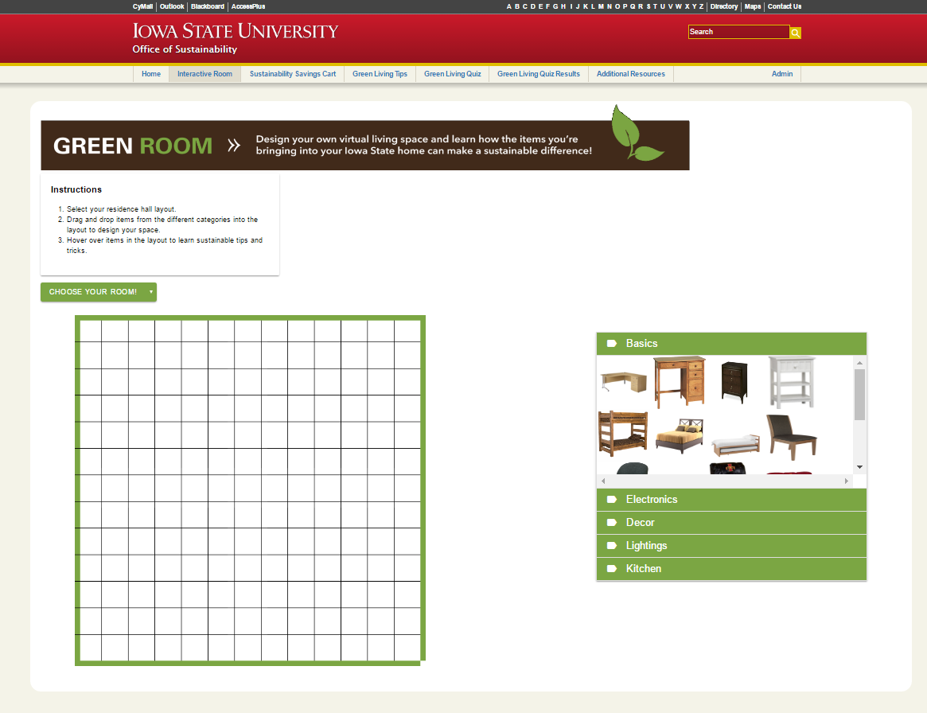
Notes:
Guan

Slide 16
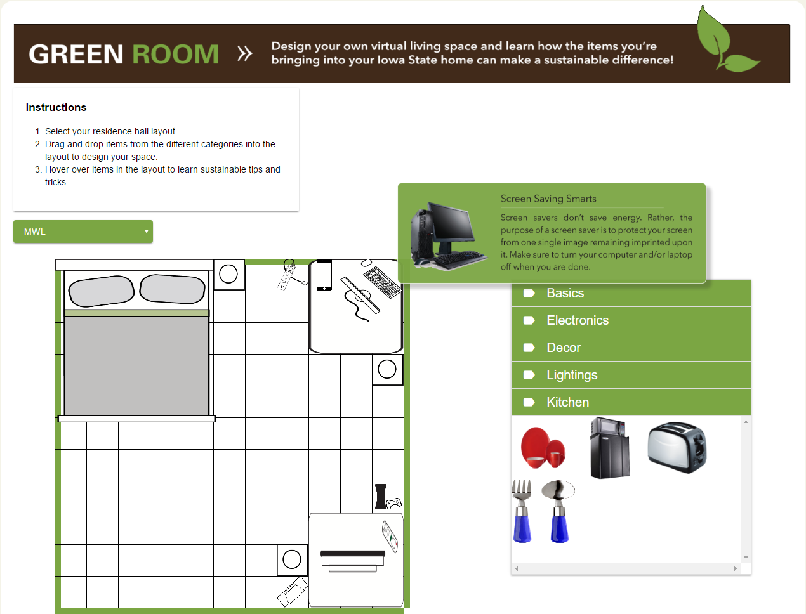
Notes:
Guan

Slide 17
Savings Cart

Slide 18
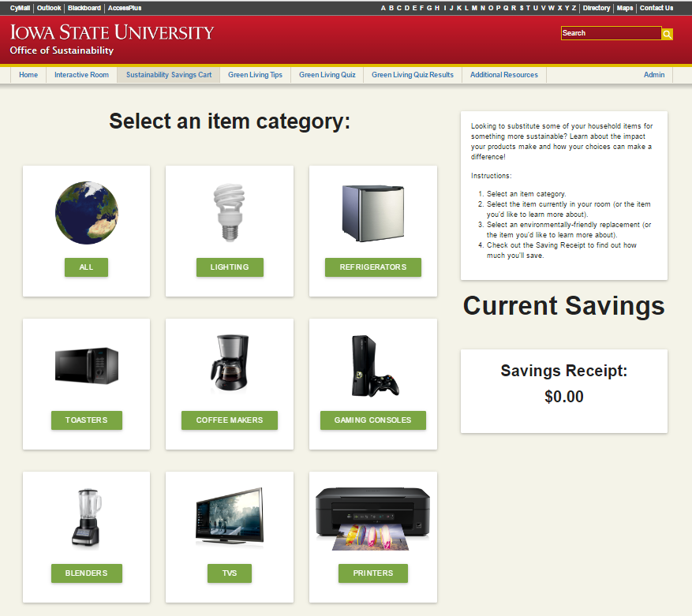

Slide 19
Information Page

Slide 20
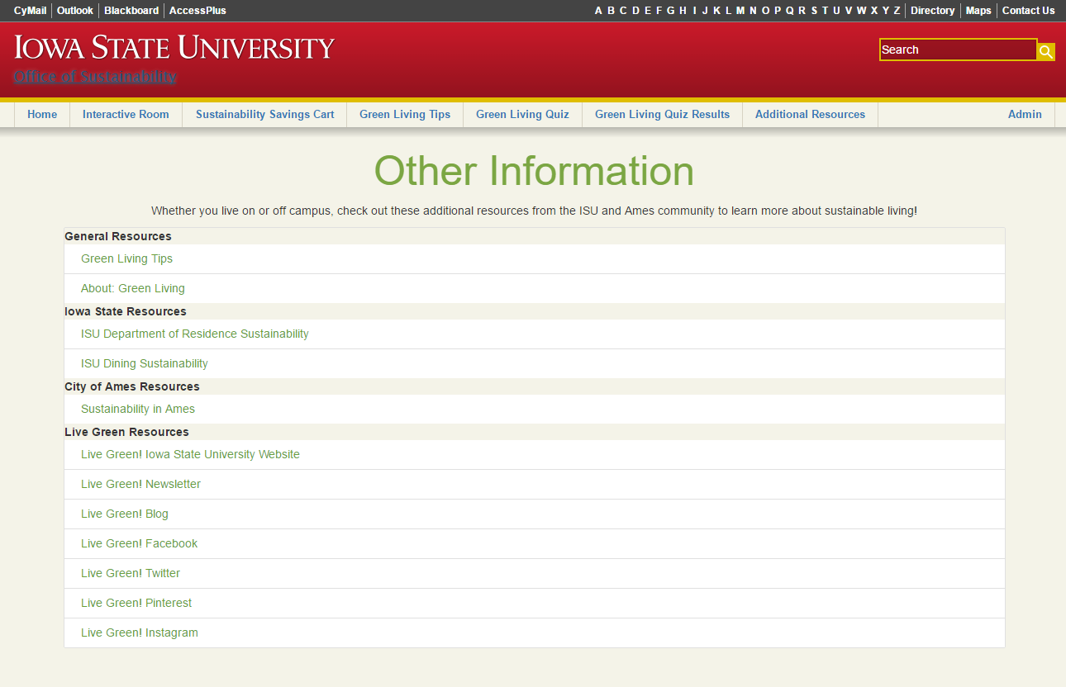

Slide 21
Green Living Facts

Slide 22
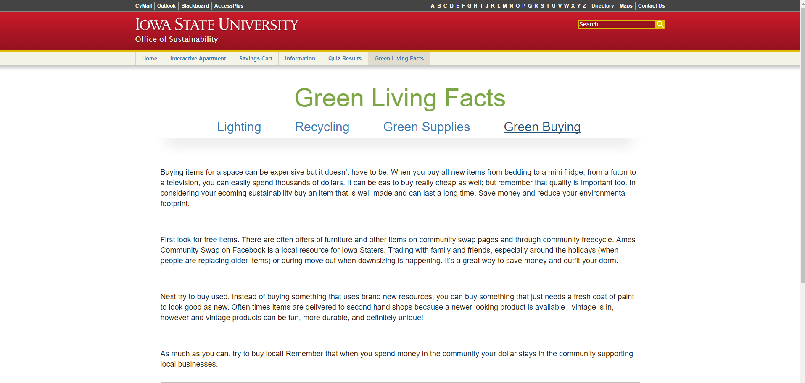

Slide 23
Demo

Slide 24
Testing
Office of Sustainability has a team of about 12 members
The team meets bi-weekly and plays with the website and relays feedback
Test Plan
UI Design
Flow of website
Functionality
Compatibility
Loading time

Slide 25
Administrative Access
& Back-End

Slide 26
Technical Challenge #2
Assigned server had none of the services the project required
No team member had prior experience with setting up a new server
Was challenging setting everything up correctly the first time
Solution:
Asked peers for help with setting up a server and related technologies

Slide 27
Evolution of Design - Back-End
Database Schema Design
Visual Design Focus
Functionality
Back-End to Front-End Integration

Slide 28
Technical Challenge #3
Node Server Crashing
The Node server would randomly crash when certain files were updated
The Node server needs to be restarted after updating the backend scripts
Solution:
Automatically restart up to 99 times before it needs manual restart via UpStart

Slide 29
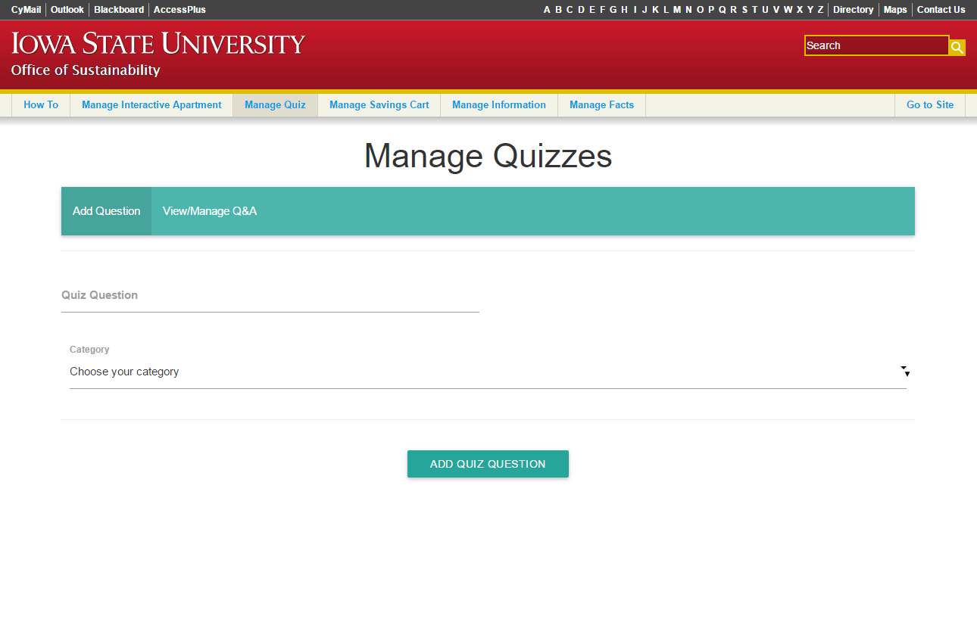

Slide 30
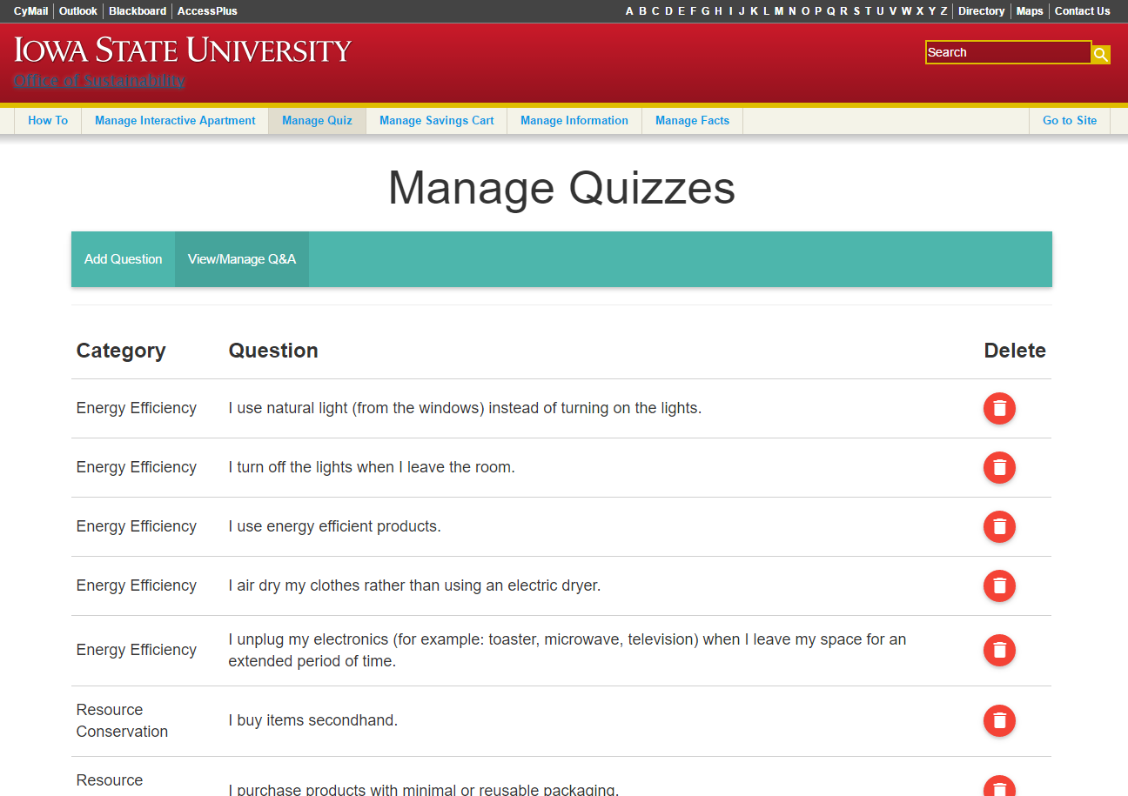

Slide 31
Demo

Slide 32
Testing
Admin:
Live Testing
Client Feedback
Database:
Live Testing
Front-End written in AngularJS

Slide 33
Technical Challenge #4
Gathering and interpreting client input to define requirements
Client is not technologically inclined which makes communicating difficult at times
The client does not fully understand what can and cannot be done with web development
Solution:
Regular weekly meetings to show progress and discuss continuing needs

Slide 34
Contact
Email
dec1612@iastate.edu
Software
greenyourresidence.ece.iastate.edu
Website
dec1612.sd.ece.iastate.edu

Slide 35
Questions?

